Slide 1

💎🚘 SmartCar Price Predictor
Yousef Barakat
Machine Learning Engineer
Data Analysis | Predictive Modeling
In the used car market, pricing is often inconsistent and unclear.
This project builds a complete machine learning system that analyzes market patterns and predicts car prices with high accuracy.

Slide 2
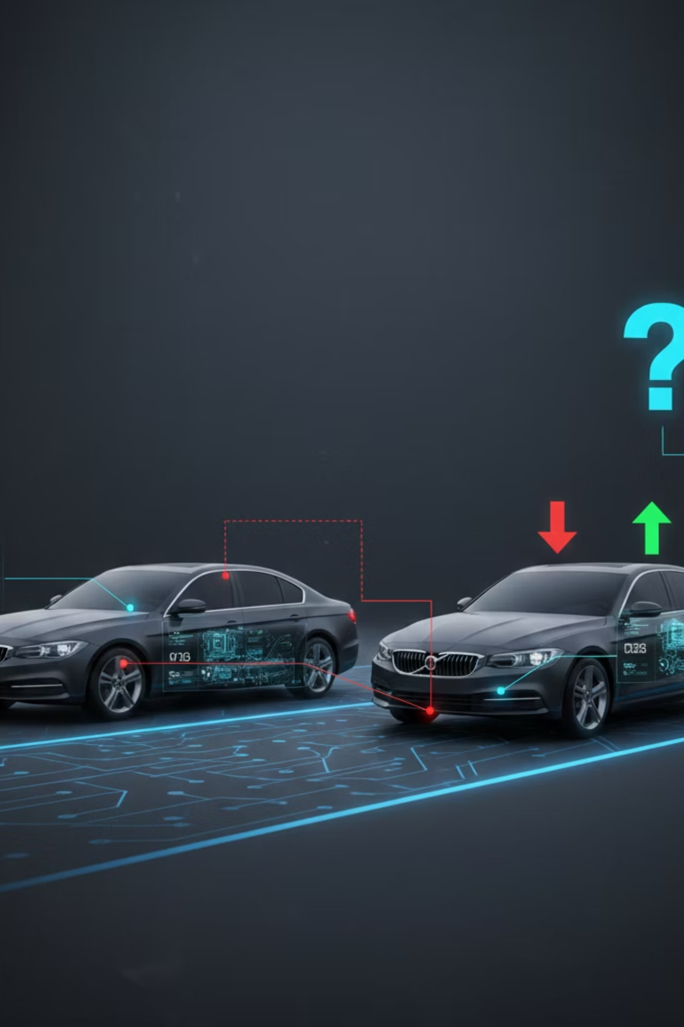
❓ Why do two cars with similar specifications have completely different prices?
🤔Is it brand?
🤔Mileage?
🤔Engine power?
🤔Market demand?
🤔Or hidden patterns we cannot see?

Slide 3


🚨 Problem Statement
The used car market lacks a transparent and reliable pricing system.
Buyers often overpay, and sellers struggle to determine the fair market value of their vehicles.
Pricing decisions are usually based on guesswork rather than data.

Slide 4

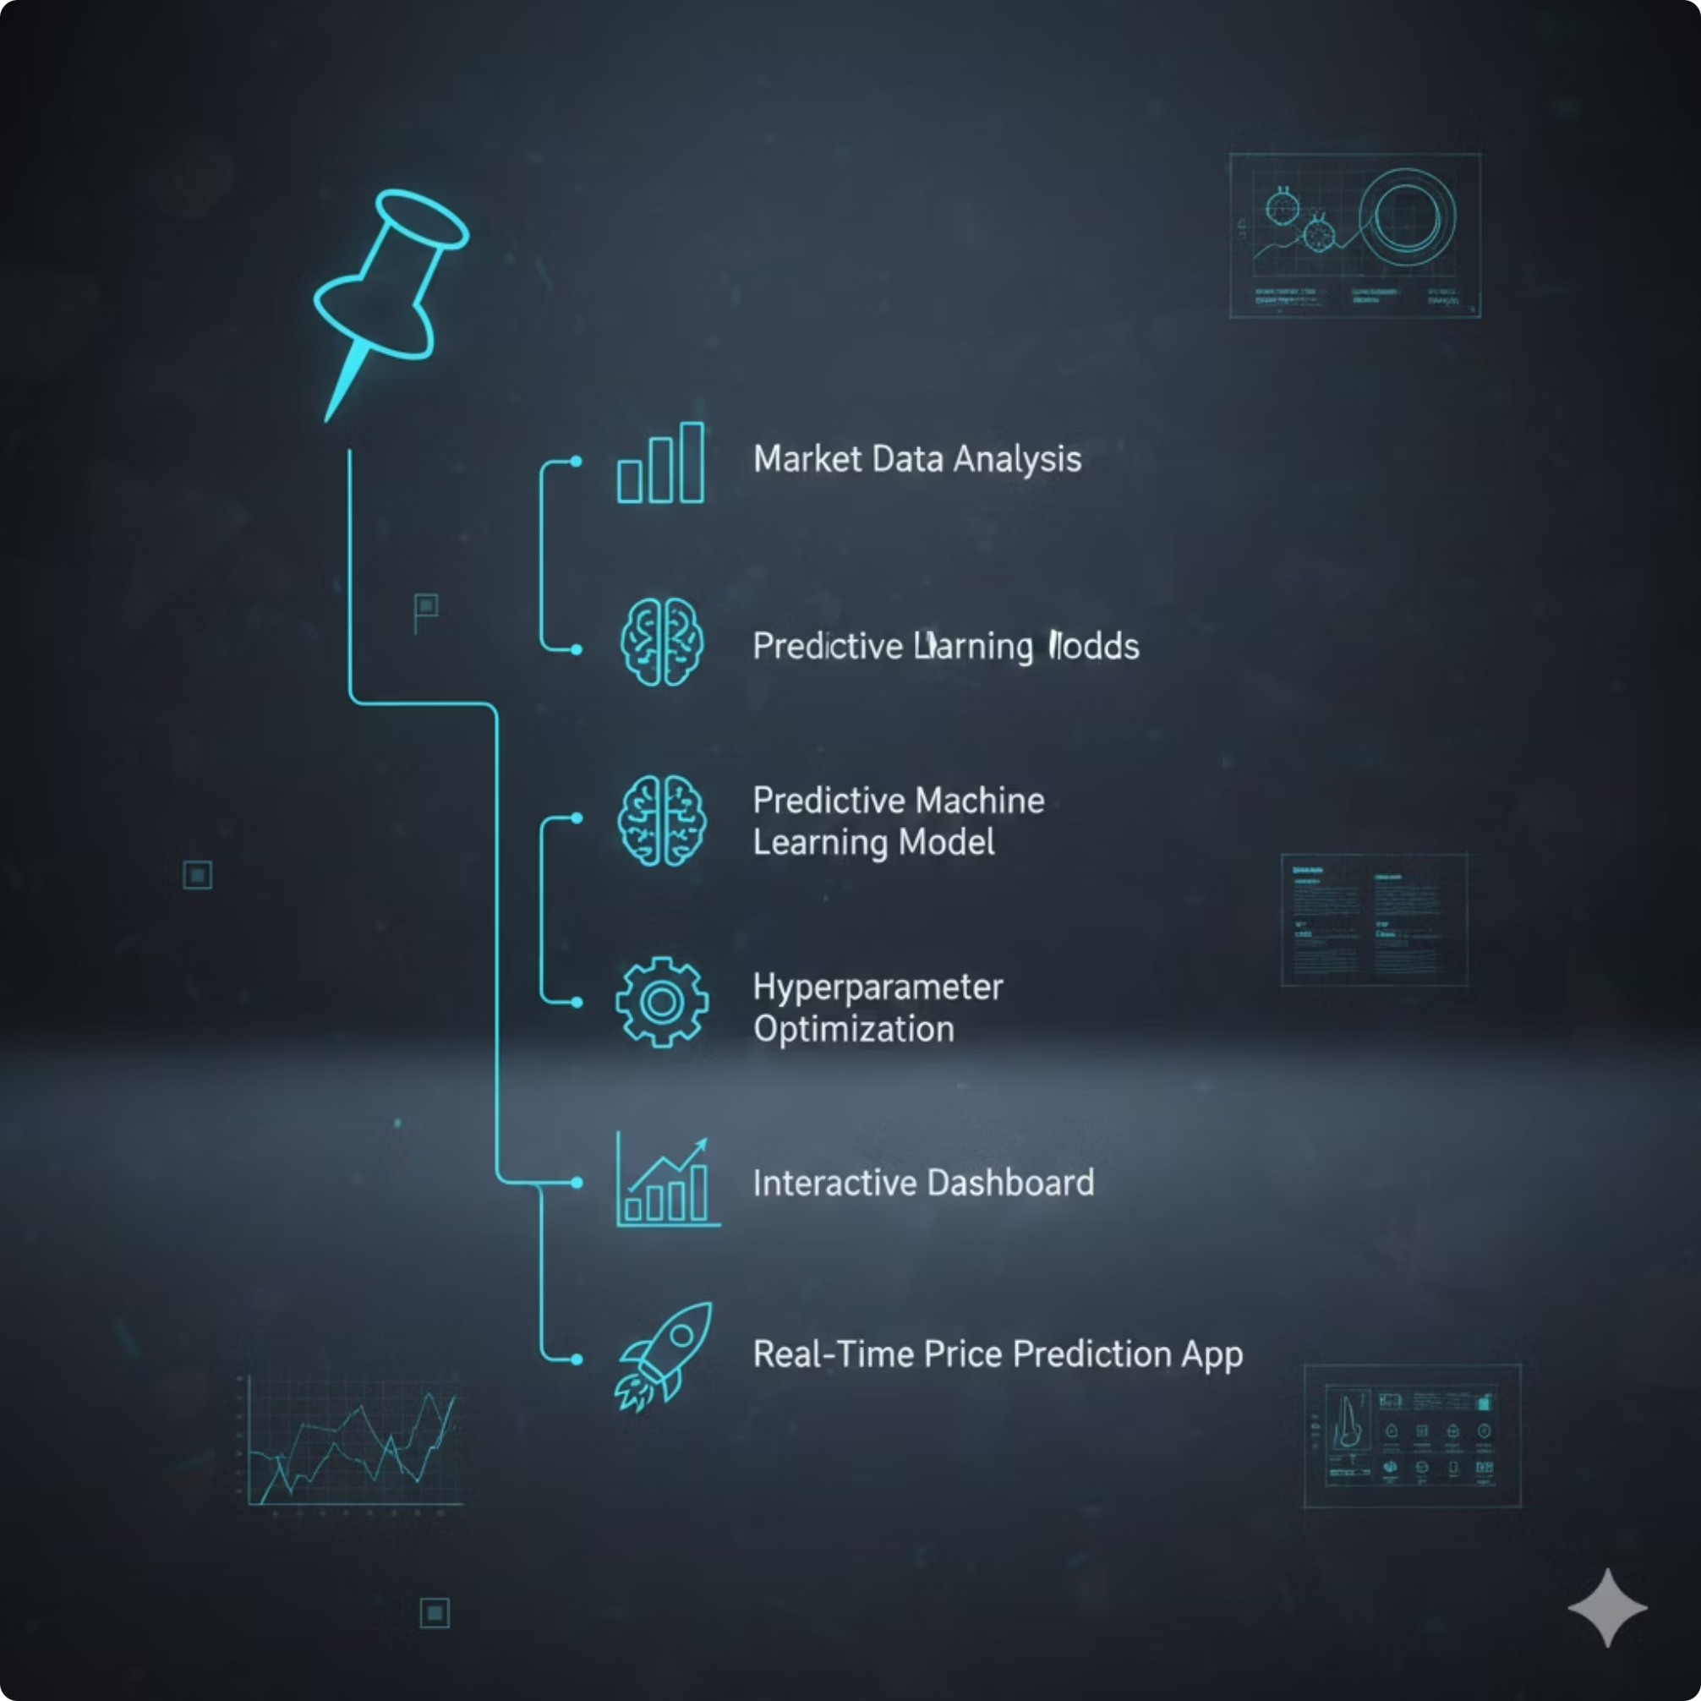
📌 Project Overview
This project delivers a complete end-to-end machine learning solution for analyzing and predicting used car prices.
🔹 The system includes:
📊 Market Data Analysis
🧠 Predictive Machine Learning Model
⚙ Hyperparameter Optimization
📈 Interactive Dashboard
🚀 Real-Time Price Prediction App

Slide 5

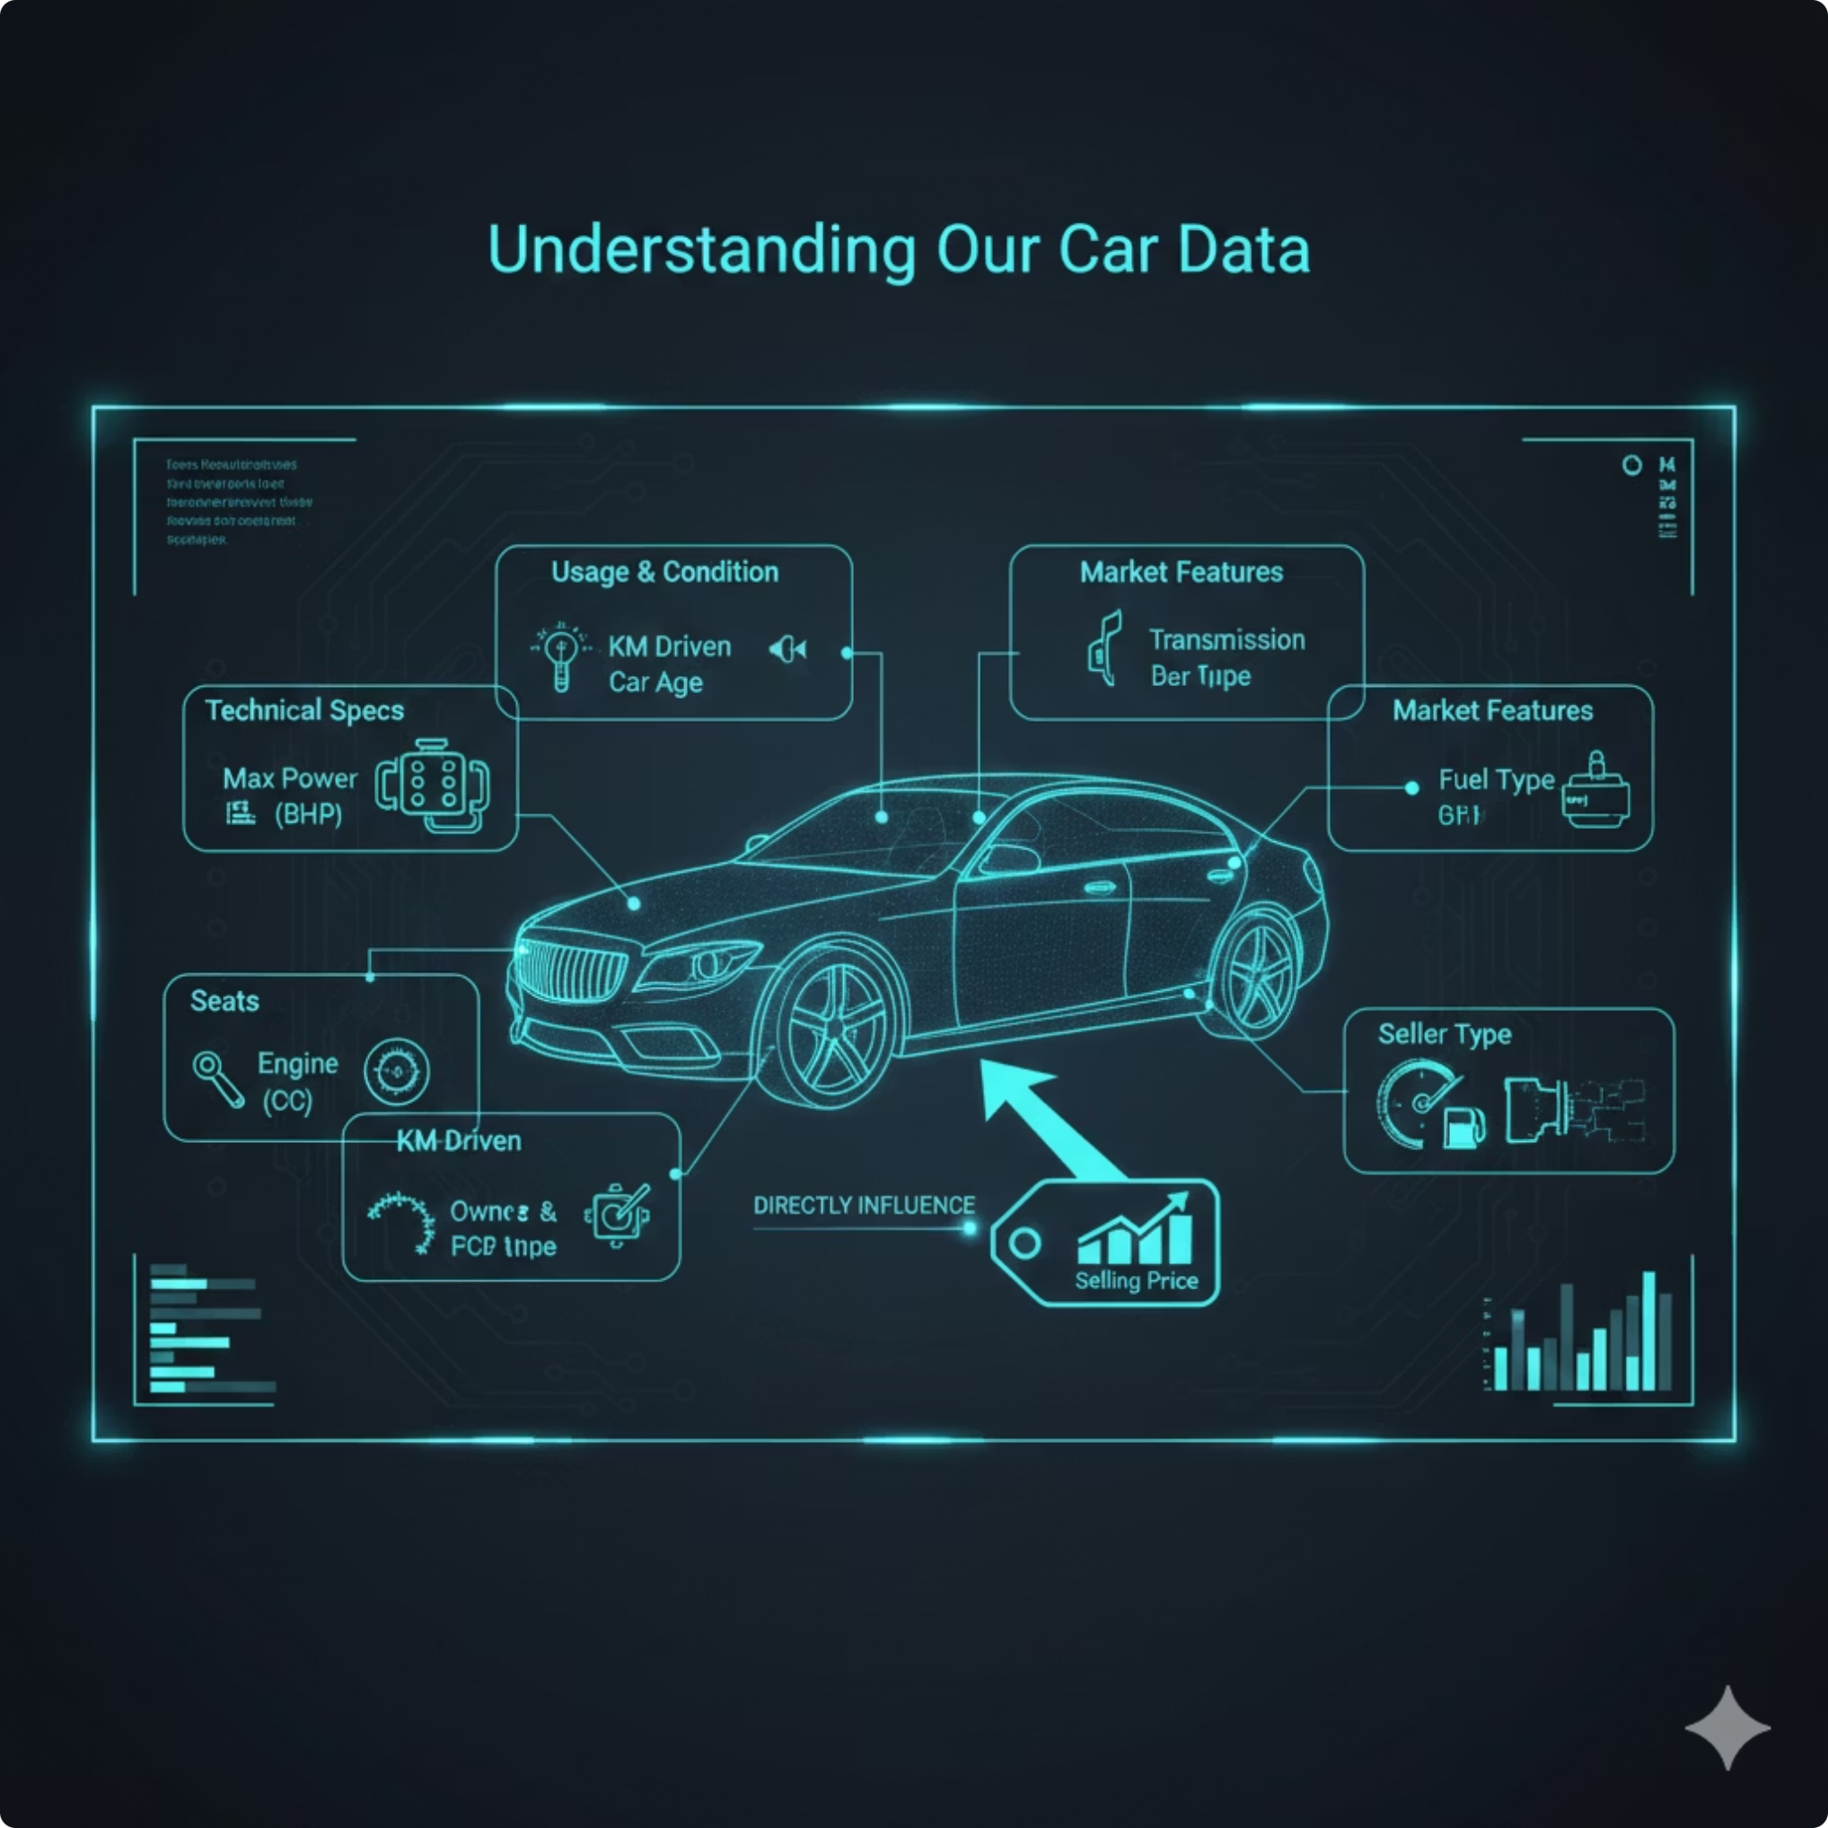
DATASET STRUCTURE
Understanding Our Car Data
Our dataset comprises critical attributes that directly influence a car's selling price, providing a rich foundation for our predictive model. Each column offers a unique insight into the vehicle's characteristics and market position.
Name: Full car model name
Year: Manufacturing year
Selling Price: Target variable
KM Driven: Total kilometers on odometer
Fuel: Type of fuel used
Seller Type: Individual, Dealer, Trustmark Dealer
Transmission: Manual or Automatic
Owner: Number of previous owners
Mileage: Fuel efficiency (kmpl/km/kg)
Engine: Engine displacement (CC)
Max Power: Engine's maximum power (bhp)
Seats: Number of seating capacity
Torque: Engine's rotational force (dropped due to high missing values)
Brand: Extracted car brand

Slide 6
Project Phases: A Detailed Checklist
Our journey to predict car prices is structured into distinct, logical phases, each building upon the last to ensure robust and accurate results.
Environment & Data Loading
1
Setting up the workspace and bringing in the raw data.
Importing Libraries
CSV Data Ingestion
Initial Data Inspection
Data Cleaning
2
Refining the dataset to ensure quality and consistency.
Unit Stripping (Regex)
Missing Value Imputation
Duplicate Removal
Exploratory Data Analysis (EDA)
Uncovering patterns and insights from the cleaned data.
3
Univariate Distribution
Bivariate Analysis
Correlation Heatmaps
Top Brands Analysis
Feature Engineering
Transforming and creating new features to enhance model performance.
4
Car Age Calculation
Ordinal & One-Hot Encoding
Target & Features Splitting
Feature Scaling
Machine Learning Modeling
Building, optimizing, and selecting the best predictive model.
5
Multiple Model Testing
Hyperparameter Tuning (GridSearch)
Best Model Selection (Random Forest)
Model & Scaler Export
Deployment & Application
6
Bringing the model to life with interactive tools for real-time predictions.
Interactive Dashboard (Plotly)
Streamlit Web Interface
Real-time Prediction Engine

Slide 7


🧹 Data Cleaning & Preparation
Goal: Transforming messy raw data into a ML-ready structured format.
✂️ String Manipulation
Problem: Units like (kmpl, CC, bhp) in numeric columns.
Action: Used Regex to strip text and convert to float.
Example: "1248 CC" ➔ 1248.0
🩹 Missing Values
Problem: Nulls in performance metrics.
Action: Applied Median Imputation for robust filling.
🚫 Duplicates & Logic Filtering
Action: Removed redundant entries to prevent Overfitting.
Sanity Check: Filtered out unrealistic data (e.g., 0 mileage, >14 seats).
🏷️ Feature Extraction
Action: Extracted Brand Name from the full car string to simplify categories and identify market leaders.

Slide 8
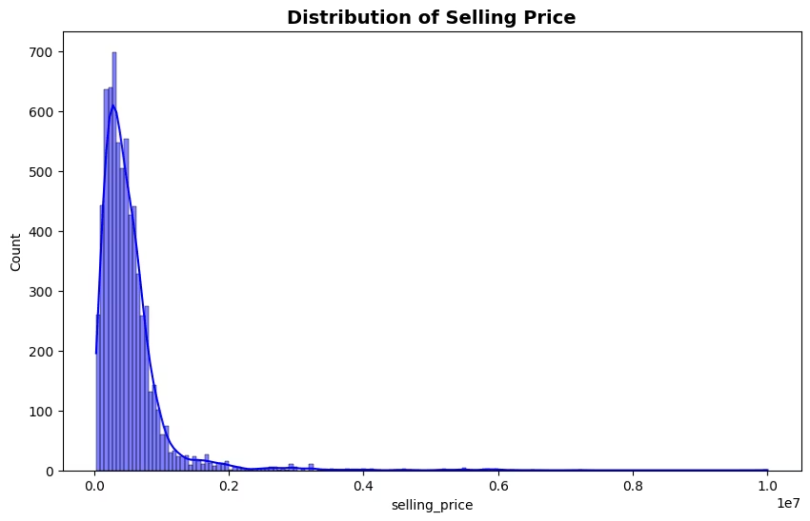
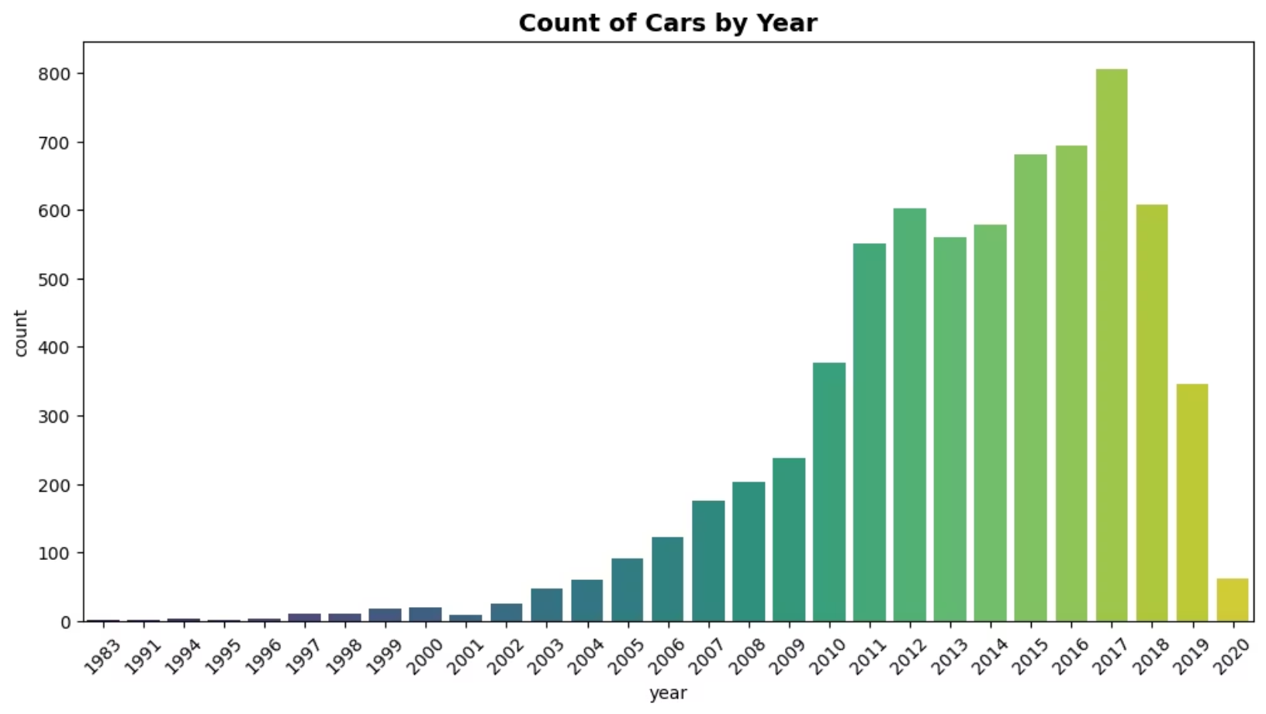
Key Data Insights (EDA) 📊
After analyzing the data, these five visualizations provided the most critical insights into the car market:
📅 Count of Cars by Year
💰 Distribution of Selling Price

Slide 9
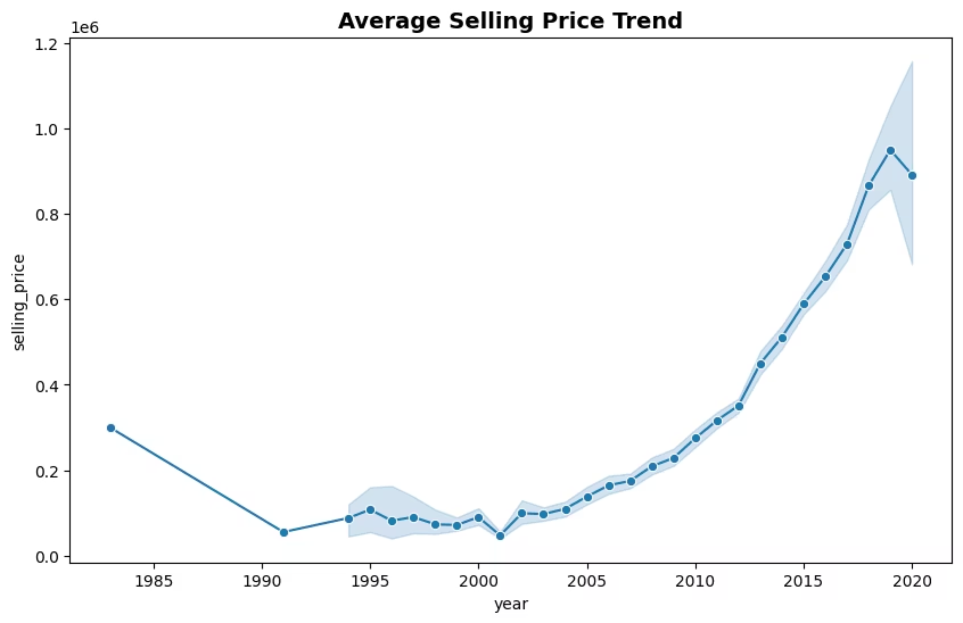
📈 Average Selling Price Trend

Slide 10
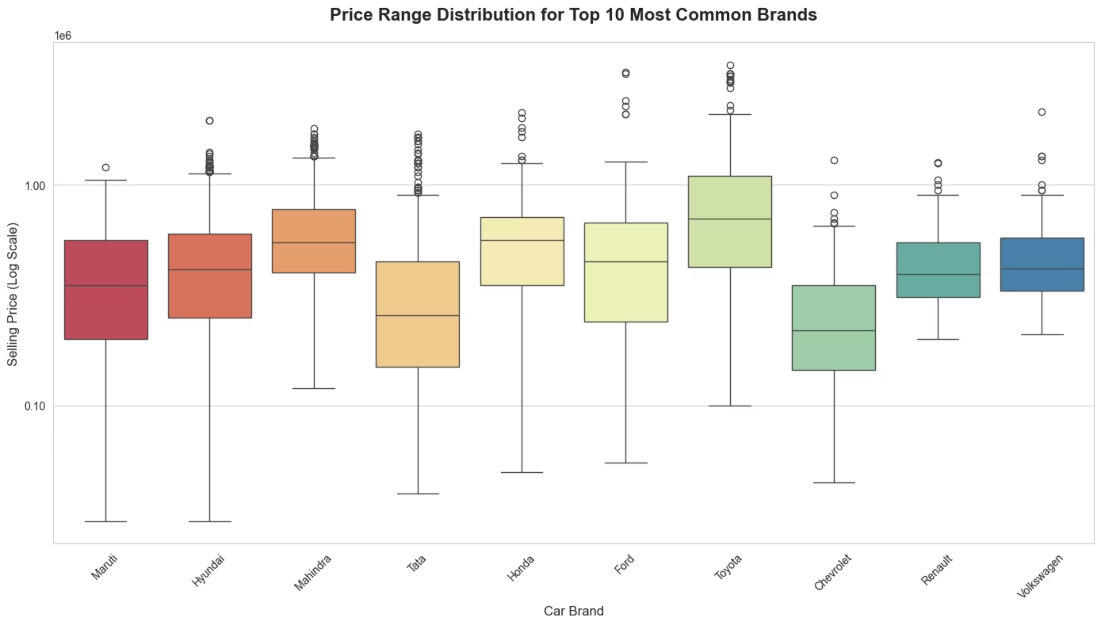
🏆 Price Range for Top 10 Brands

Slide 11
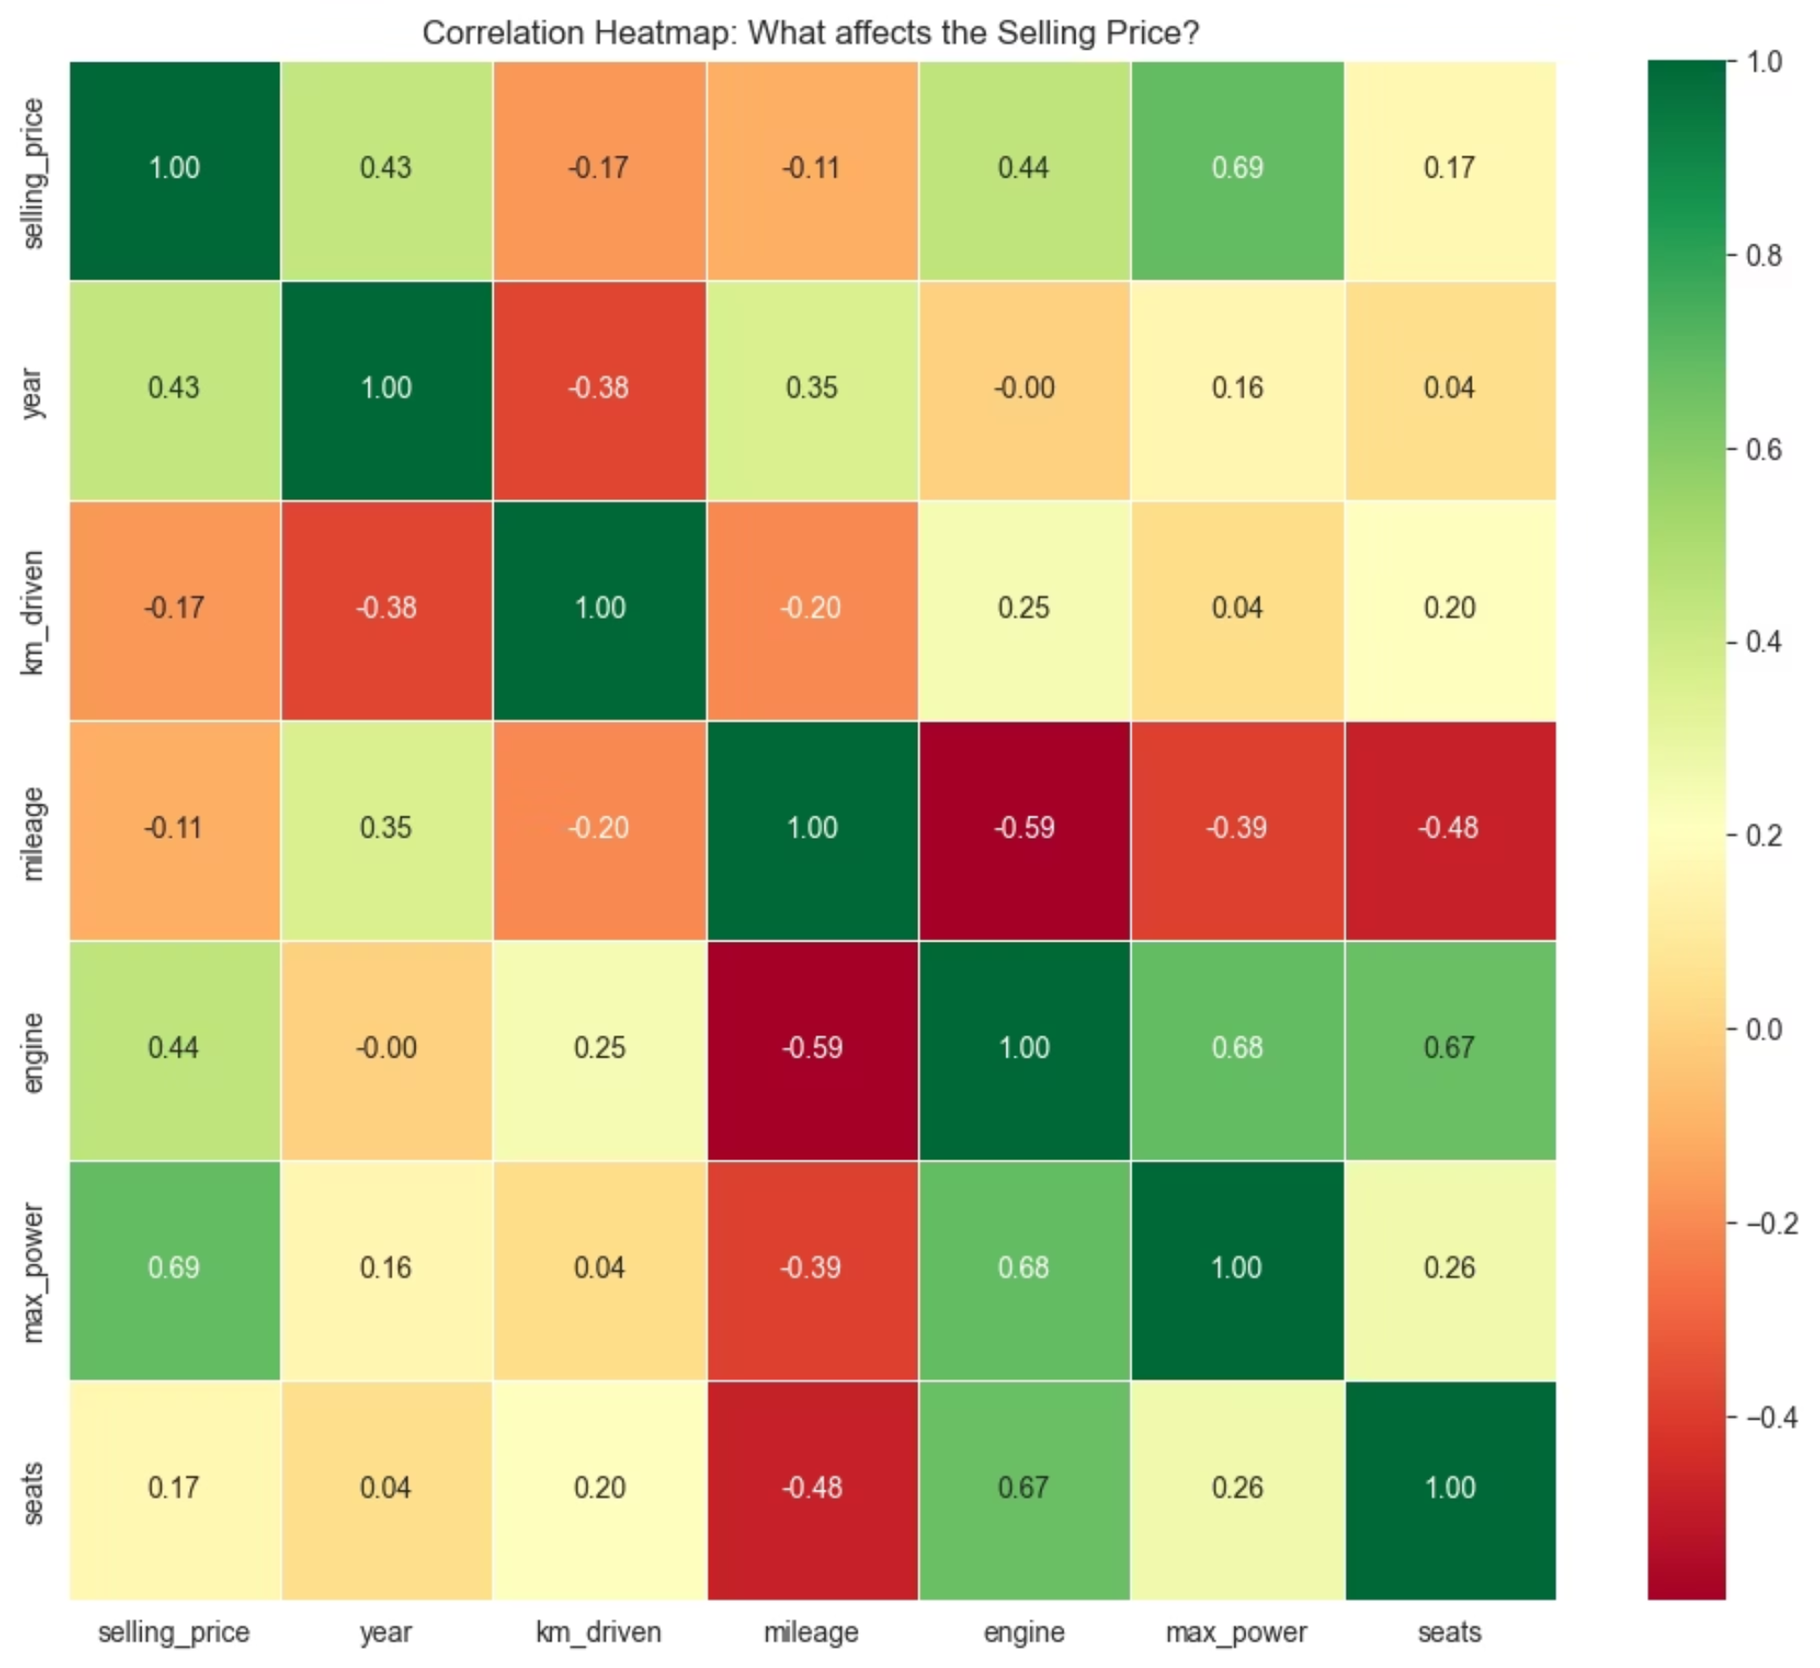
🔥 Correlation Heatmap: What affects Price?

Slide 12
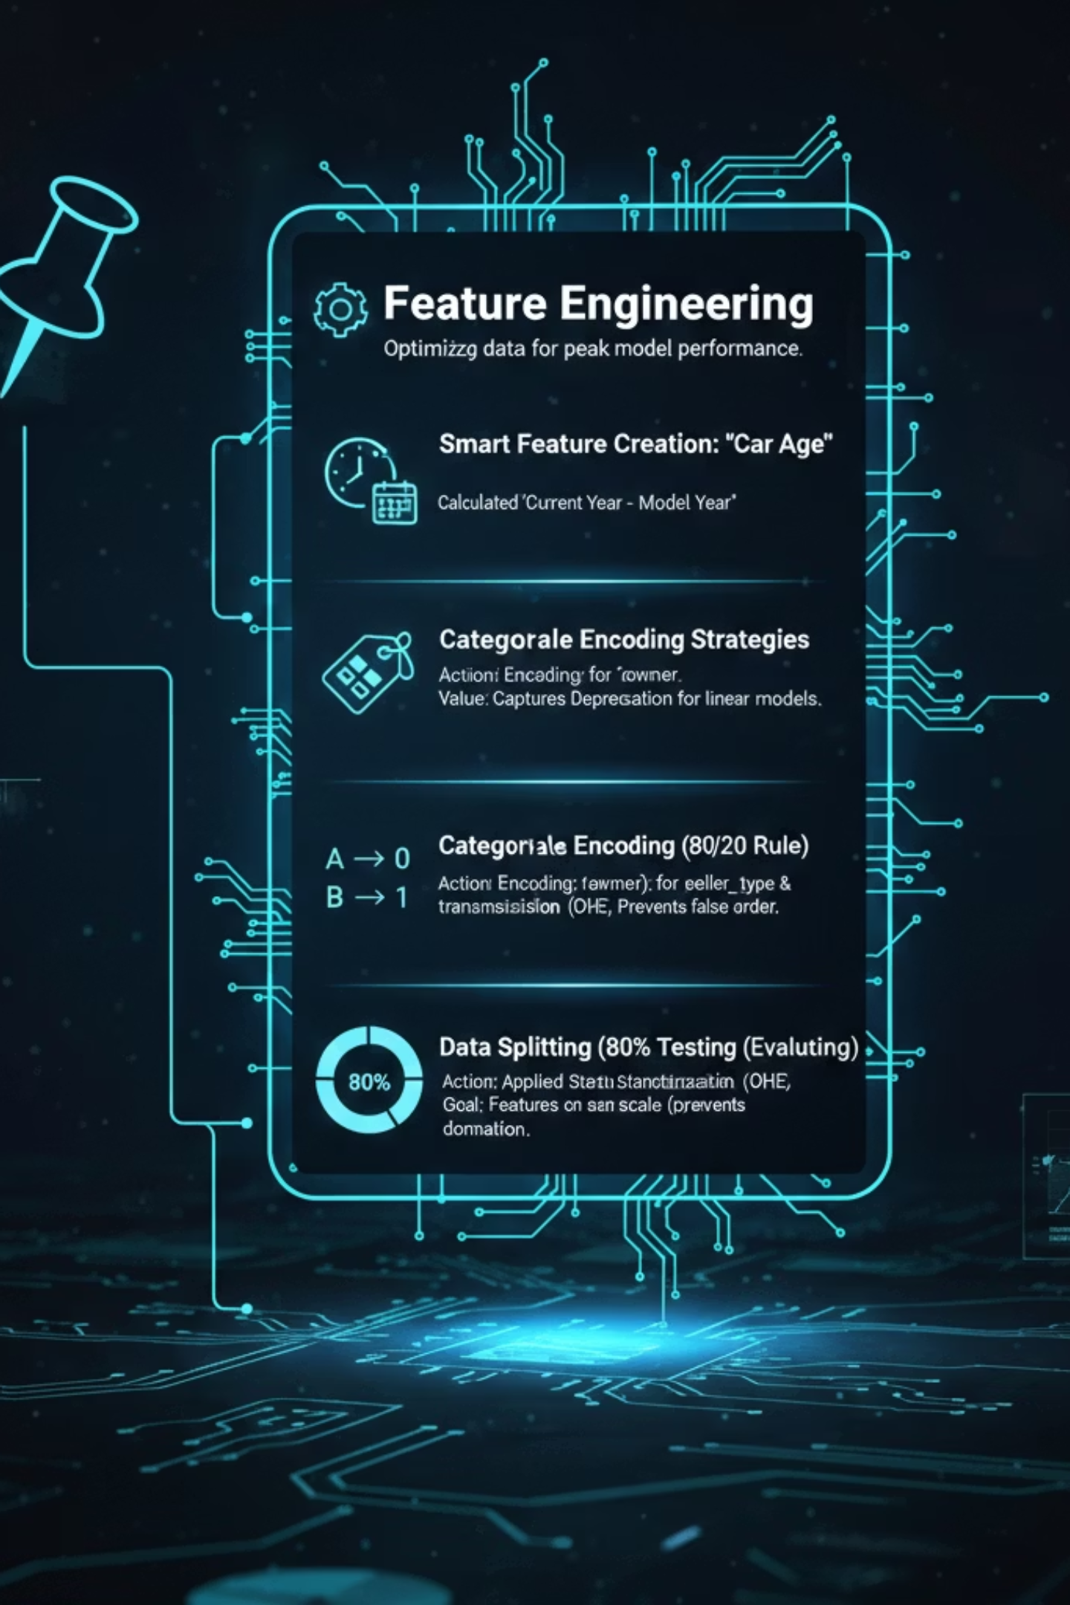
⚙️ Feature Engineering
Goal: Optimizing data representation to boost model accuracy and predictive power.
⏳ Smart Feature Creation: "Car Age"
Action: Calculated Current Year - Model Year.
Value: Linear models capture Depreciation (الاستهلاك) much better through "Age" than raw "Year" timestamps.
🔢 Categorical Encoding Strategies
Ordinal Encoding: Used for owner. Preserves the logical rank (e.g., First Owner > Second Owner).
One-Hot Encoding (OHE): Used for fuel, seller_type, & transmission. Prevents the model from assuming a false mathematical order between categories.
🎯 Data Splitting (80/20 Rule)
Action: 80% Training (Learning patterns) | 20% Testing (Evaluating performance).
⚖️ Feature Scaling (StandardScaler)
Action: Applied Standardization to ensure all features (like KM vs. Seats) are on the same scale, preventing large numbers from dominating the model.

Slide 13

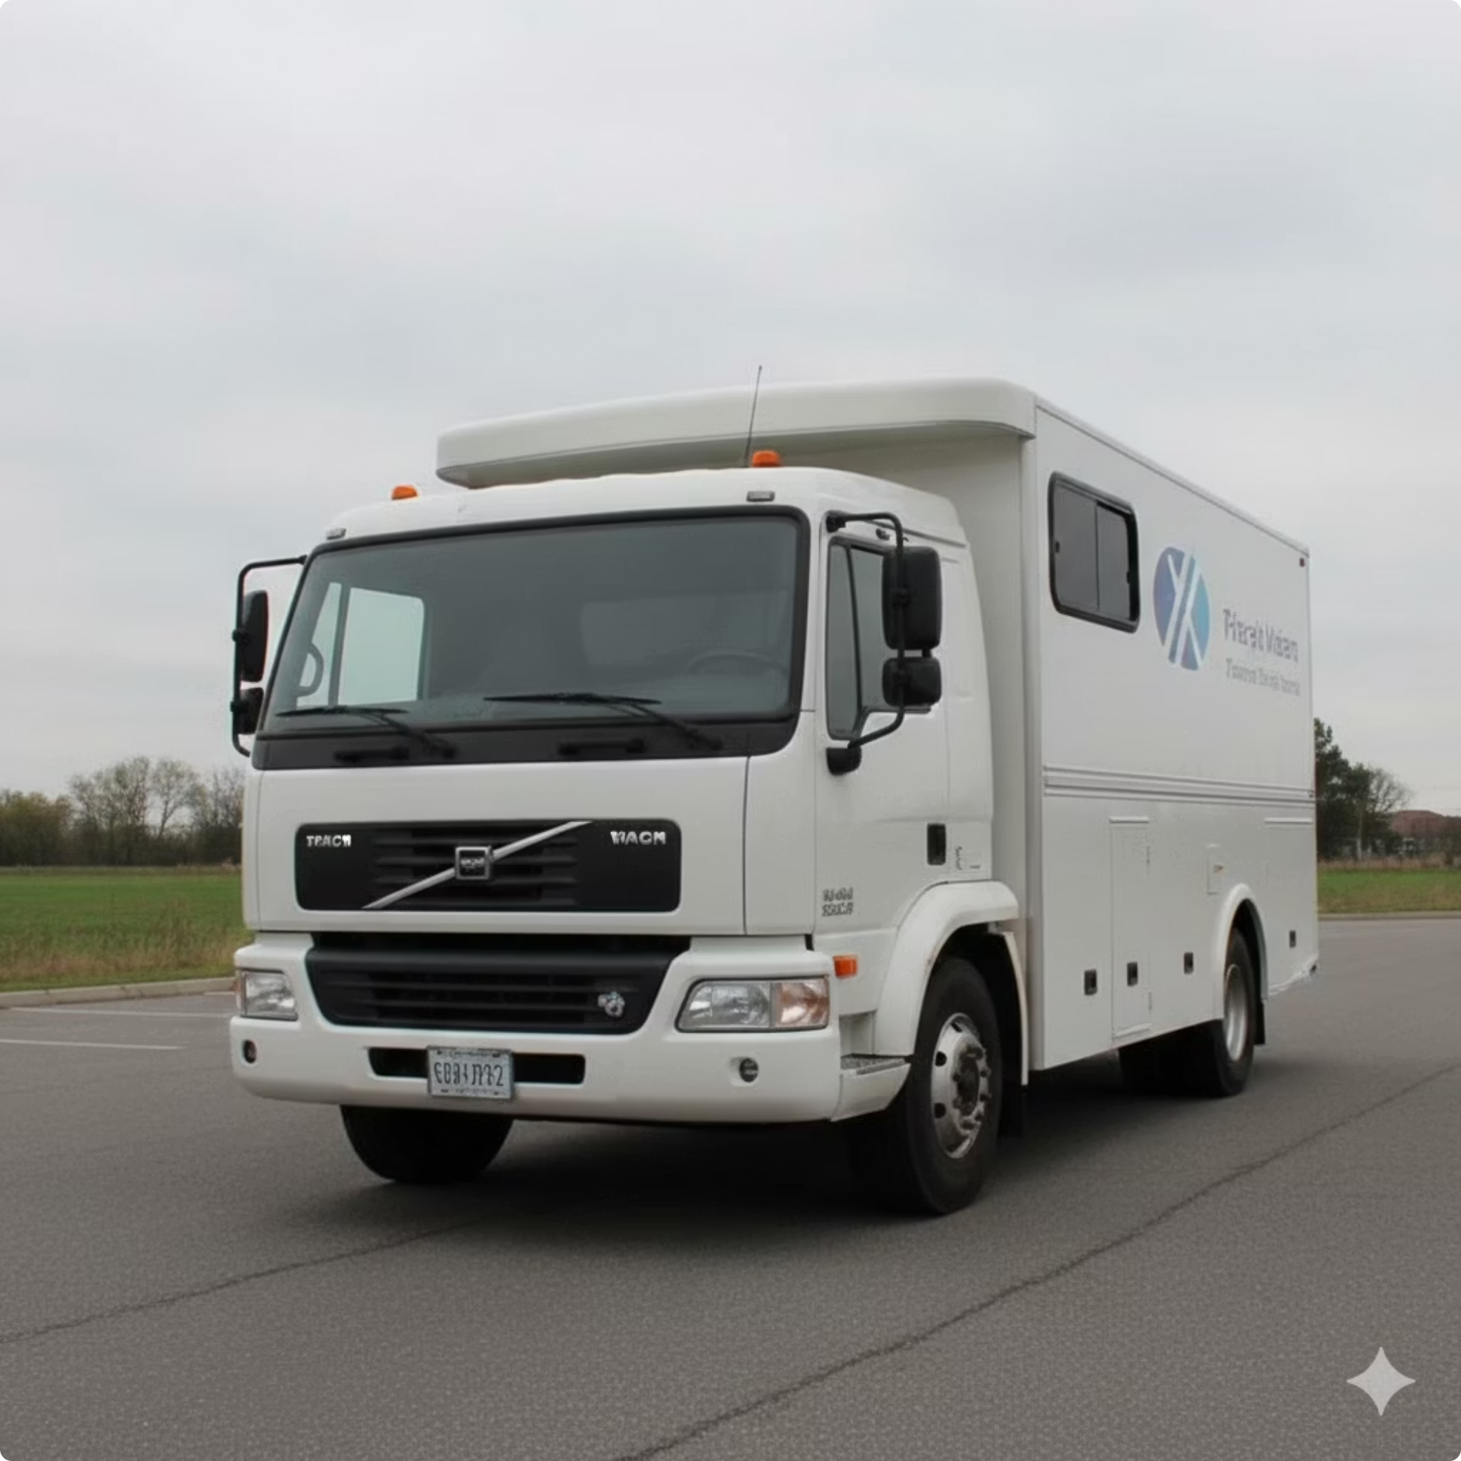
MODEL BUILDING & RESULTS
Selecting the Best Predictive Model
We evaluated several regression models to find the most accurate predictor for car selling prices, leveraging GridSearchCV for optimal hyperparameter tuning.
1
2
3
Linear Regression
Lasso Regression
Decision Tree Regressor
A baseline model to establish initial performance benchmarks.
Introduces regularization for feature selection and preventing overfitting.
A non-linear model capable of capturing complex relationships within the data.
4
Random Forest Regressor
An ensemble method, often providing high accuracy and robustness. This model achieved the best performance with an R² score of ~85%.

Slide 14
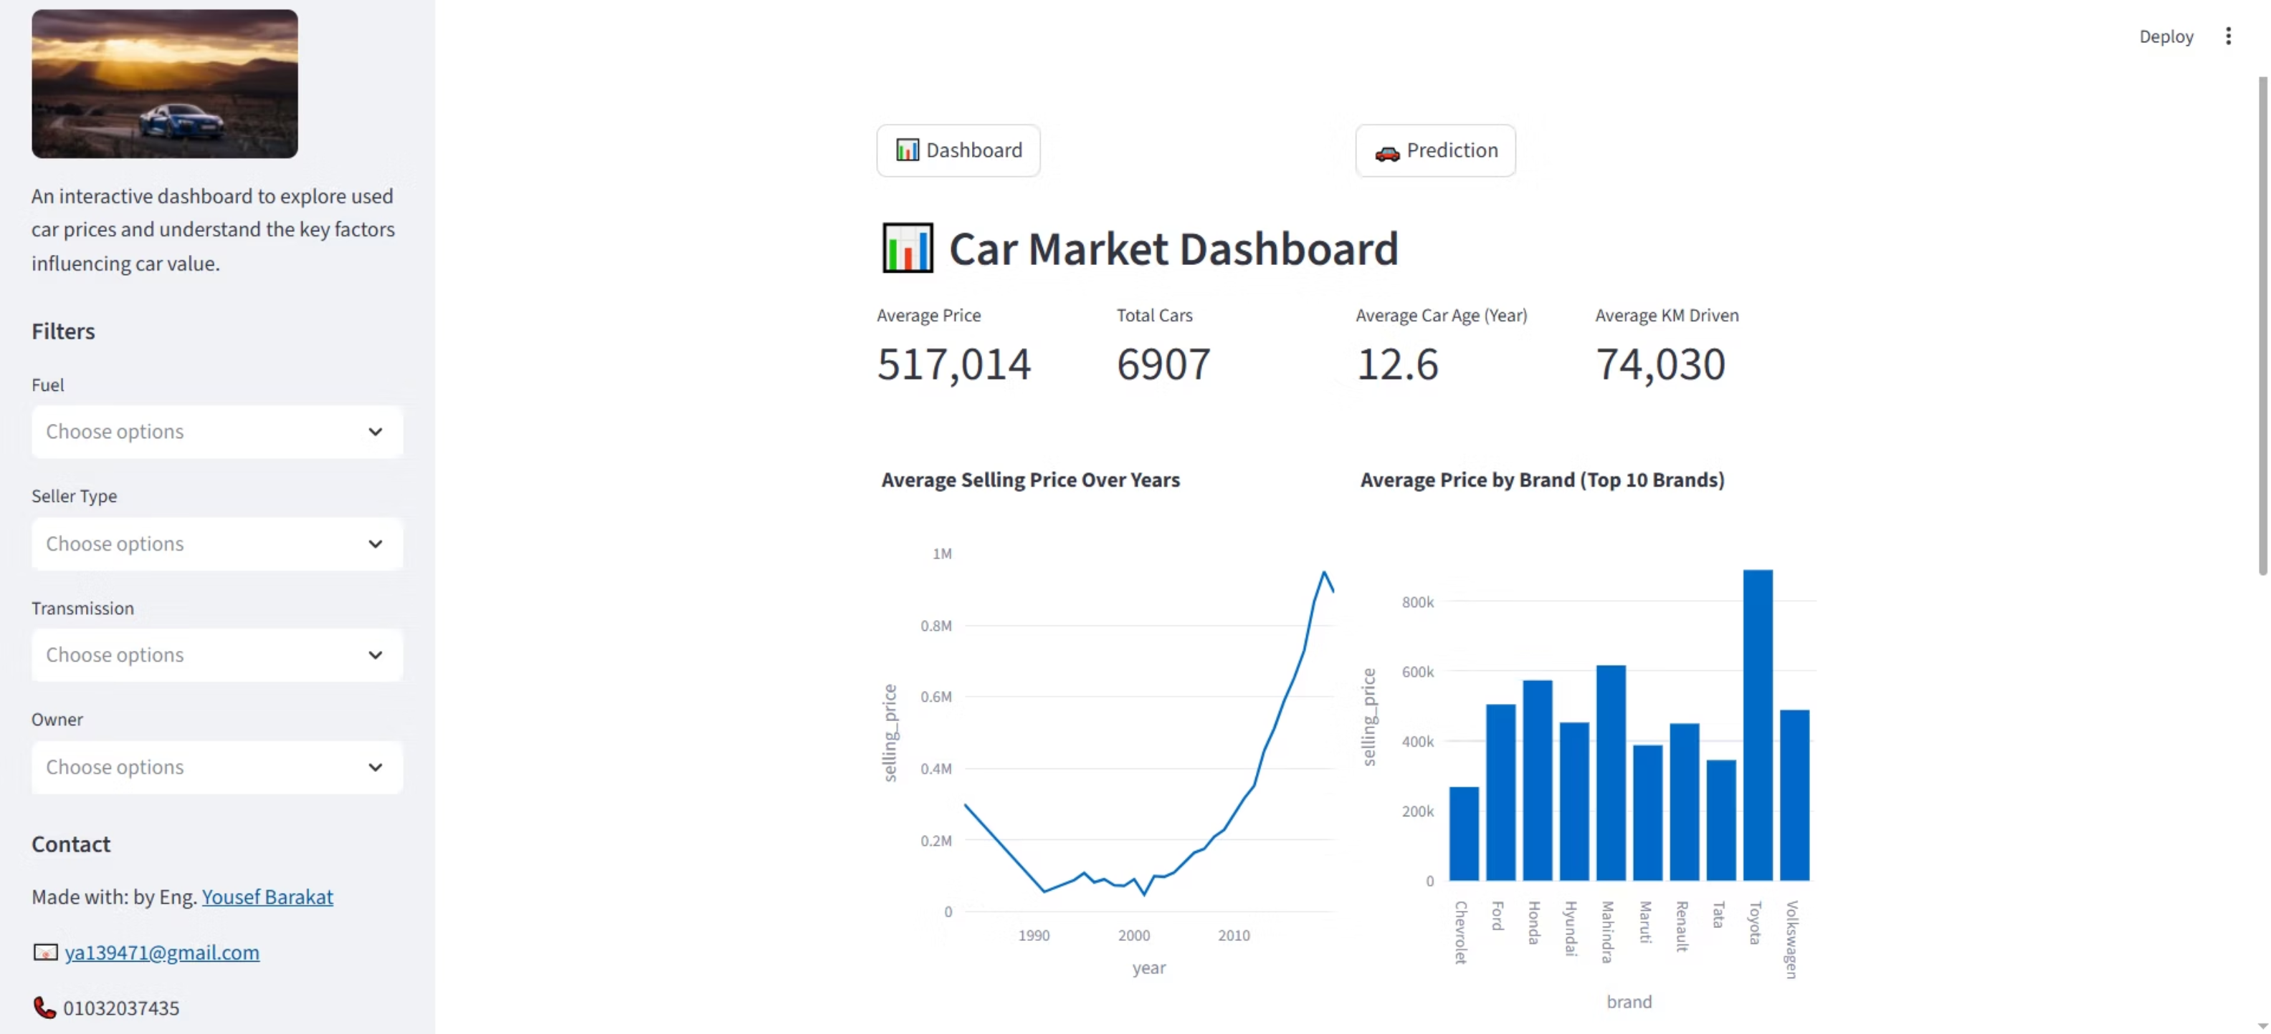
6. Deployment & Live Application 🚀
The final stage was bringing the model to life by building an interactive web application, allowing users to get real-time price estimates.
🖥️ Interactive Web Interface (Streamlit)

Slide 15
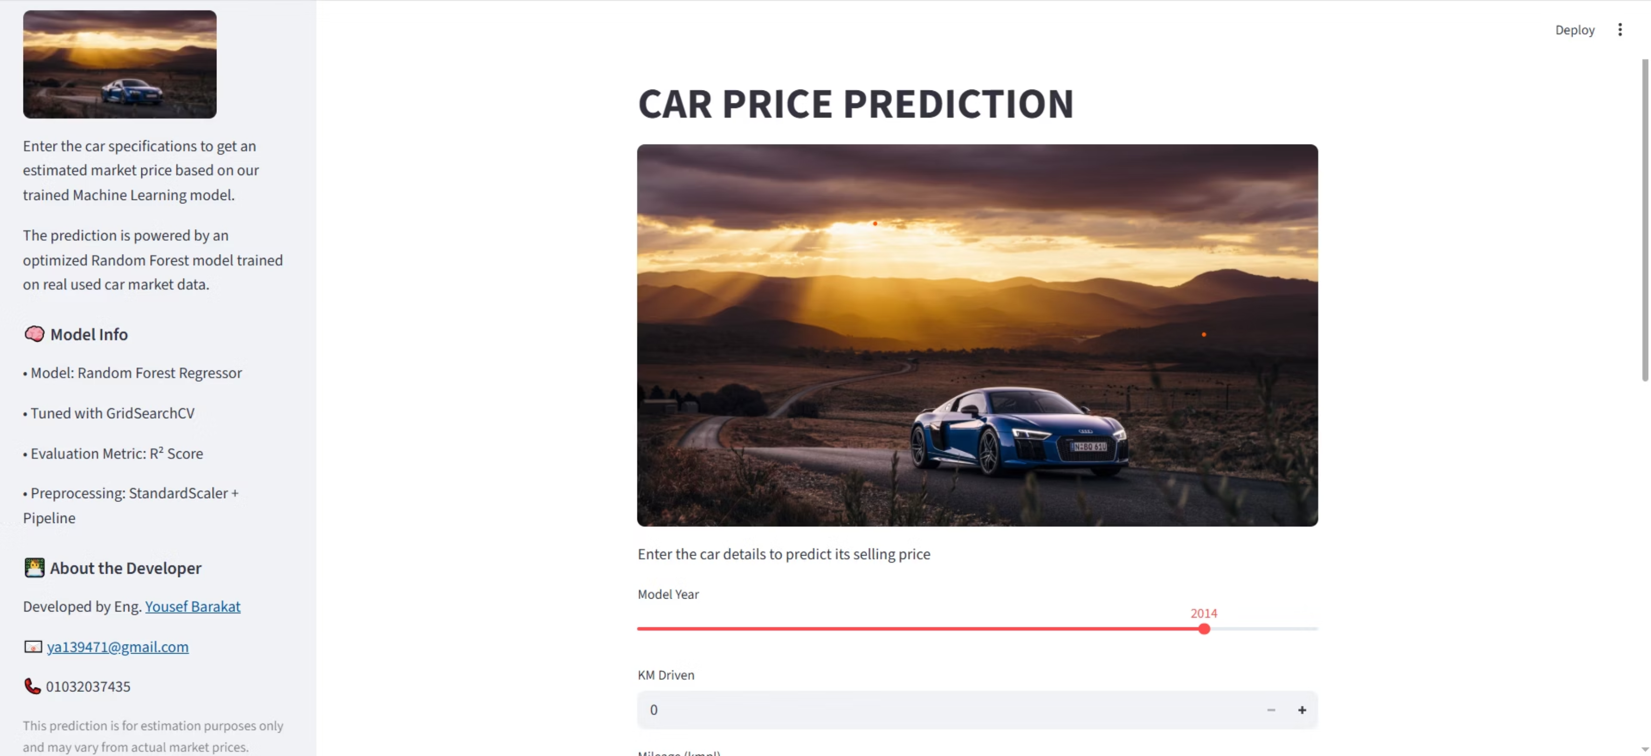
🔮 Real-Time Prediction Engine

Slide 16
